Slide 1
Tic-Tac-Toe Game
Roberto Perez
Paris, France

Slide 2
Tic-Tac-Toe Game Roberto Perez,Paris, France
Introduction to Tic-Tac-Toe:
Tic-Tac-Toe, also known as "X and O" or "Noughts and Crosses," is a classic and simple two-player game. It's played on a 3x3 grid where players take turns marking the grid with their symbols to achieve a winning pattern. The goal is to be the first to form a line of three of your symbols, either horizontally, vertically, or diagonally.
Let's begin the game:

Slide 3
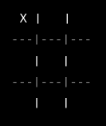
Tic-Tac-Toe Game Roberto Perez,Paris, France
Round 1: 'X' plays
Explanation: In the first round, 'X' takes the first move, placing an 'X' in the top-left corner of the grid.

Slide 4
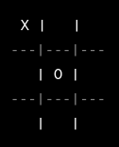
Tic-Tac-Toe Game Roberto Perez,Paris, France
Round 2: 'O' plays
Explanation: Now, 'O' makes the second move, placing an 'O' in the middle of the grid.

Slide 5
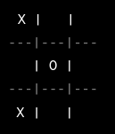
Tic-Tac-Toe Game Roberto Perez,Paris, France
Round 3: 'X' plays
Explanation: 'X' takes another turn and places an 'X' in the bottom-left corner.

Slide 6
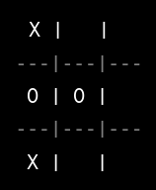
Tic-Tac-Toe Game Roberto Perez,Paris, France
Round 4: 'O' plays
Explanation: 'O' makes their move, putting an 'O' in the middle-right.

Slide 7
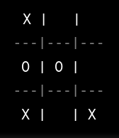
Tic-Tac-Toe Game Roberto Perez,Paris, France
Round 5: 'X' plays
Explanation: 'X' continues by placing an 'X' in the bottom-right corner.

Slide 8
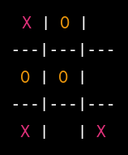
Tic-Tac-Toe Game Roberto Perez,Paris, France
Round 6: 'O' plays
Explanation: 'O' makes their move and places an 'O' in the top-center position.

Slide 9
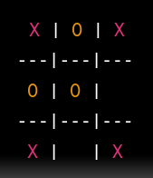
Tic-Tac-Toe Game Roberto Perez,Paris, France
Round 7: 'X' plays
Explanation: 'X' takes their turn and wins the game by placing an 'X' in the top-right corner, completing three 'X's in a diagonal.
X | | ---|---|--- | | ---|---|--- | |

Slide 10
Tic-Tac-Toe Game Roberto Perez,Paris, France
'X' has won the game! If you'd like to play another round or have any other questions, please feel free to ask!
Congratulations

